Slide 1
AutoBill
Authors:
Puzhuo Li, Chih-Yu Lee, Cheng Tian
Xinghan Qin, Qizhan Liu, Jia Wen
Meeting Time
Thursday 12:30 library
Sunday 14:00 online
GitHub
https://github.com/JamesLi0217/SSW690Project

Slide 2
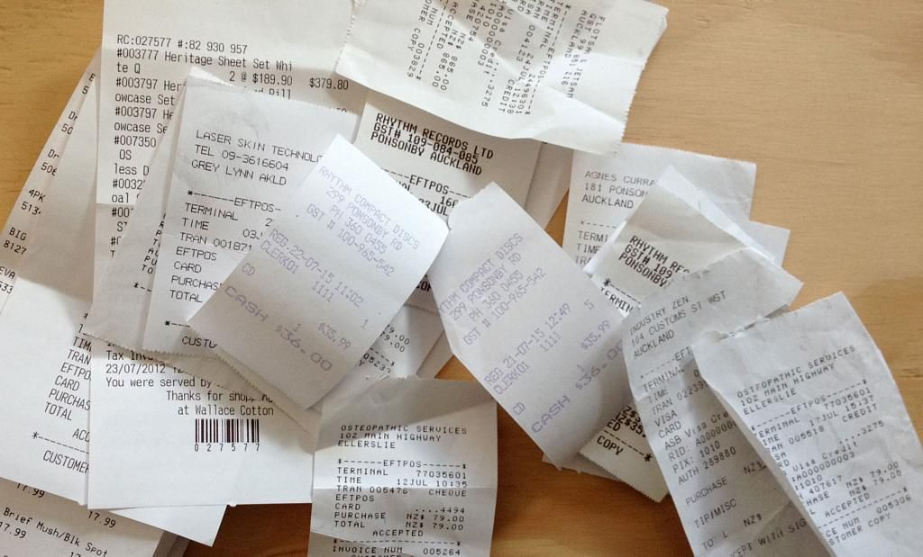
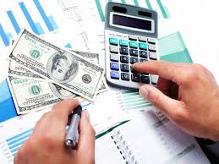

Introduction
Receipts Calculation Arguments

Slide 3
Background
Nowadays, entertainment has become more and more abundant, people spend time eating, traveling and having fun with friends. When people check their credit card bill and salary card balance in the end of the month, they often wonder where did the money go, how can I split the bill with my friends? Therefore, bookkeeping and bill collection have gradually become essential parts of people's lives.
Although some applications have the bill-split function, they are not very efficient and useful and they have many restrictions when used in daily lives.
Therefore, our AutoBill app have emerged.

Slide 4

Aims and Objectives
Aims:
This application can help customers easily, efficiently and safely deal with bills.
Objectives:
Create group chat function
Create rules during the bill report and check out
Develop an algorithm to separate the bills
Simplify the user’s operations
Top up and withdraw money

Slide 5



Customers
For people who travel with friends.
For people who live with other roommates.
For people who create and attend party frequently.
For ANYONE who DEAL WITH BILLS!

Slide 6
Major Features
Features | Priority
Submit a request with description, bill amount and receipt picture | 5
Distribute the bill to each other | 5
Create groups and invite their friends to join in | 4
Confirm the request | 4
Register/delete their own accounts | 4

Slide 7
Major Features
Features | Priority
Edit their personal profiles | 3
Check group bill history | 3
Chat with their friends in group | 2
Use the app to take pictures of the receipts | 2
Protect users’ personal information | 1
Deposit and withdraw money | 1

Slide 8
Conclusion
Less receipts
Less calculation
Less time on the bills
More comfortness
More secured
Notes:
In conclusion, this app will reduce the usage of receipts, and there will be less calculation for participants. Users would only have to upload the receipe’s photos, expense, and the amount of consumers in their group chat, and after that just wait for the other members to confirm the pop up notification. Users will spend less time on the overall bills. This app will be convenient and comfort for users.

Slide 9
Thanks
Q&A

